Slide 1

Leanne Park
Amit Patankar
Vedika Prakash
Vivek Rangaswamy
Matthew Wong
Voyager Consulting

Slide 2
Agenda
Procedure
Critical Elements
Companies
Miscellaneous

Slide 3

Procedure
Database Research
Data Acquisition
Analysis
Researched different databases and contacted professors in order to better have an understanding of both the technology and the industry
Contacted different companies in the social gaming industry to ascertain their database needs
Analyzed both the data provided by the companies and the professor and our own insights to come up with several clients and use cases for Aerospike
This procedure allowed us to most efficiently and effectively come up with clients and strategies
Procedure
Critical Elements
Companies
Miscellaneous

Slide 4
Latency
Scalability
Throughput
Critical Elements

Slide 5
Latency
Trends
Importance
Latency is one of the more crucial things that companies are looking for in database systems.
As companies are using more and more data, latency is increasing in importance
Latency will continue to increase in importance in the years to come
Latency is a big enough need that some companies will consider switching databases to improve it, but they need to evaluate the other specifications of a database.
Almost every company that we contacted has either had an issue with latency in the past or is looking to improve latency now. This is critical for the utility of a site, and it’s important to look for companies with severe latency issues, since this is one of Aerospike’s strong suits.
Companies
Phoenix Guild (MongoDB)
Nordeus (Postgres)
Three Rings Design (Postgres)
Zynga (MySQL)
Latency is one of the more pressing issues that Aerospike will have to deal with in the near future.
Procedure
Critical Elements
Companies
Miscellaneous

Slide 6



Scalability
Trends
Importance
Companies recognize scalability as critical for game development. While some are already looking for higher scalability, others believe that it might become a concern in the near future as their user base grows. Some of the companies are already looking at companies and hence can make for a potential clientele. For others, it can be useful soon.
It is extremely important as the usage and users for companies grows with time. In social number, a large number of users can be playing a game at the same time, which increases the role on the server, hence requiring higher scalability.
Companies
Wooga (MySQL, Redis, Riak, Couchbase)
SocialPoint (MySQL, tried CouchDB and Cassandra)
Three Rings (PostGreSQL)
Phoenix Guild (MongoDB)
Companies are facing minor scalability issues now and will probably face significant ones in the near future.
Procedure
Critical Elements
Companies
Miscellaneous

Slide 7
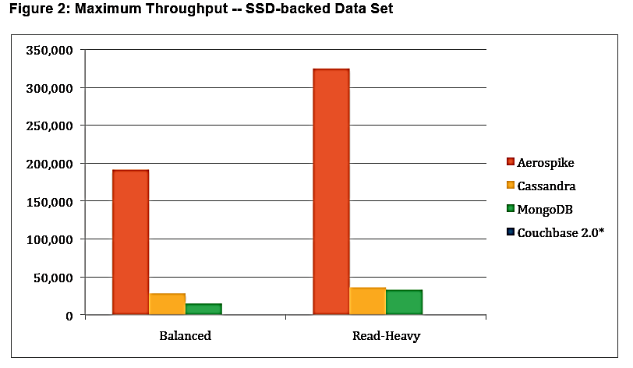
Throughput
Trends
Importance
Throughput is critical, but not at the moment
Currently none are experiencing any problems with it
In the future, they may be forced to update
Aerospike’s high throughput levels may not be needed by the industry at the moment
Upgrading for higher throughputs may not be financially worth it
Social games have many read and writes happening per second, it is critical that they do not saturate their input-output bandwidth.
Companies
Free Range Games (NoSQL & SQL)
Lvl6 (MySQL)
Three Rings (PostGreSQL)
Zynga (MySQL)
Source: Aerospike
Throughput is not a pressing issue in the present, but may become crucial in the future.
Procedure
Critical Elements
Companies
Miscellaneous

Slide 8
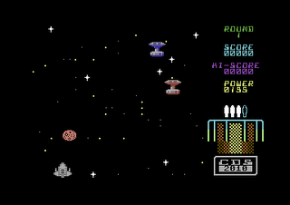
Awareness and Literature
Trends
Importance
Most student based start up gaming companies use mySQL because of awareness and literature online
Currently many are experiencing any problems with it
Hire professionals to teach database courses or self startup classes that use Aerospike architecture
Make students aware that there is another popular choice out there
Many major games start in dormitory or home office. Aerospike needs to increase its presence in these environments as a viable option.
Companies
Bhonsle Games(mySQL)
Lvl6 (mySQL)
Awareness and literature is a pressing issue in the present, but may not become crucial in the future.
Procedure
Critical Elements
Companies
Miscellaneous

Slide 9
Lvl6
Nordeus
Phoenix Guild
Social Point
Wooga
Three Rings Design Inc.
Zynga
Companies

Slide 10

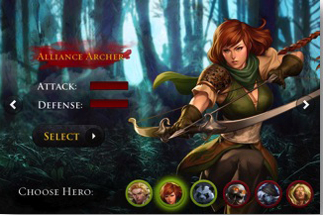

lvl6
Fact Sheet
Over 100 thousand daily active users
Created Age of Chaos, one of the most popular massively multiplayer online game
Platforms across Android and iOS
Breakout mobile gaming company in Mountain View
Why they are key?
In just less than a year, lvl6 has a massively multiplayer online game with over 100,000 users and active players. This got the attention of incubator, Y Combinator, who awarded them with a top 10 2012 idea award.
Procedure
Critical Elements
Companies
Miscellaneous

Slide 11

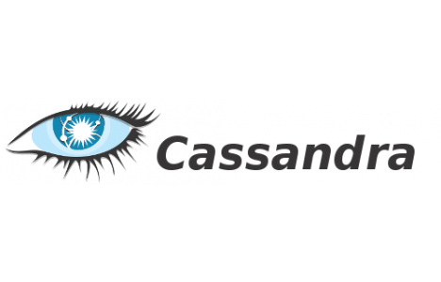


lvl6 Databases
Leaderboards for games
Statistics, rollups, and various data
Log in data and functionality
Warehouse
Procedure
Critical Elements
Companies
Miscellaneous

Slide 12
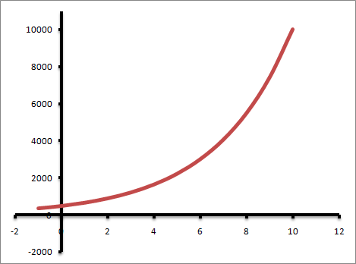
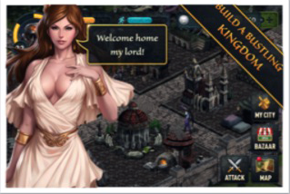
lvl6
Scalability
Since lvl6 uses MySQL now, it is going to hit a write limit eventually. With even more users registering and Age Of Chaos rapidly growing, scalability is a key issue for lvl6’s future database choices. Currently to bypass this issue they are considering sharding or indexing to keep compatibility with current code base.
User Acquisition
Procedure
Critical Elements
Companies
Miscellaneous

Slide 13
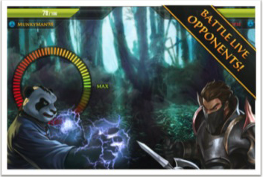
lvl6
Throughput
On a massively scalable and very responsive game such as Age of Chaos, throughput is important. With multiple interactions in a massively multiplayer game there are millions of interactions of data. Especially to support battles, locations, communications, friends, and other features, lvl6 needs database architecture that allows for fast read and write transactions.
Procedure
Critical Elements
Companies
Miscellaneous

Slide 14
Nordeus Overview
About
Social network sports gaming company in Belgrade, Serbia
Games
Have been boostrapping the company for the past 3 years
Growth Potential
Top Eleven Football Manager is one of the most popular fantasy football games in Europe
This is their only game—version 2.0 was released in October 2012
Not actively looking for funding—looking instead for partners who can help them further their product
CEO: Branco Mulitinovic; CTO: Milan Jojovic (former Microsoft engineers)
10 million daily active users
Have been profitable for a while now
Top Eleven reached top 10 games on Facebook in Dec 2012
Nordeus is one of the most popular sports games makers in Europe
Procedure
Critical Elements
Companies
Miscellaneous

Slide 15

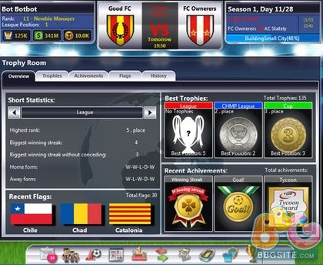
Nordeus Databases
Background:
Developed as a more “beefy” MySQL—has more featured, but is slower
Problems:
Postgres had known latency issues
There are concurrency issues when using large data
It is only possible to insert one item at a time
Heroku just announced that there was a serious security hole with Postgres Monday
Slony-I, the replicator for Postgres, is very slow (n² time)
Nordeus is using Postgres because “it has been around for a long time,” among other reasons.
Procedure
Critical Elements
Companies
Miscellaneous

Slide 16


Nordeus Use Cases
Nordeus Issues
Aerospike Solutions
Nordeus said that “NoSQL is a no for us” because they don’t use unstructured data
Aerospike can market the fact that it can be used for both structured and unstructured data to target firms that are unsure about NoSQL
Nordeus can use real-time data interaction for KPI testing
Aerospike can market it’s real-time data interaction to everyone—almost all companies need or want to use it
Real-time interactions will be very important when new players are released and users need to get their specific player instantaneously
Real-time data interaction and structured data are important marketable features
Procedure
Critical Elements
Companies
Miscellaneous

Slide 17
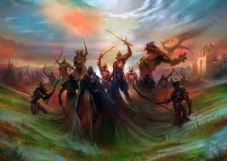

Phoenix Guild
About
Located in San Francisco but not yet launched
Planning short term for about a million users and long term up to 50 million
Jason Citron (CEO)
Growth Potential
$1.1M in total funding
Identified by Venture Beat as the door to the “post-PC world of gaming”
Phoenix Guild is a brand new social gaming company that has gained much interest from VC’s.
Procedure
Critical Elements
Companies
Miscellaneous

Slide 18

Phoenix Guild Databases
Background
Planning to use NoSQL, in particular MongoDB
Planning on having a large number of users
Uses
Fast real-time data interaction will be used for iPad application
-Quick access to player’s data like inventory, character names, and friend’s list
Problems
Expecting scalability to be a large problem
Wooga is planning on using MongoDB but forsees problems with scalability.
Procedure
Critical Elements
Companies
Miscellaneous

Slide 19
Phoenix Guild Results
Current Issues
Correctness is more important than speed as of now
However, throughput will be important once scalability becomes issue
Interested in predictable low latency
Does not plan on updating current database until scalability issues arise
Aerospike
Scalability
Predictable Low Latency
Focus on scalability and on how Aerospike is an option down the road when there are problems
If Aerospike focuses on its benefits to the issue of scalability, it can be a replacement for MongoDB.
Procedure
Critical Elements
Companies
Miscellaneous

Slide 20
Social Point
About
Social networking gaming company in Barcelona
30 million monthly active users
Andres Bou (CEO) and Marc Canaleta (CTO)
Growth Potential
$14.7M in total funding
In the top 25 for gain in monthly active users by 3% on AppData for Dragon City
Named one of the top 5 global developers of social games by Crunchbase
Games
4 million daily active users for Dragon City
18 million monthly active users for Social Empires
13 million monthly active users for Social Wars
Social Point has the largest jump in users, showing great promise as a potential client.
Procedure
Critical Elements
Companies
Miscellaneous

Slide 21
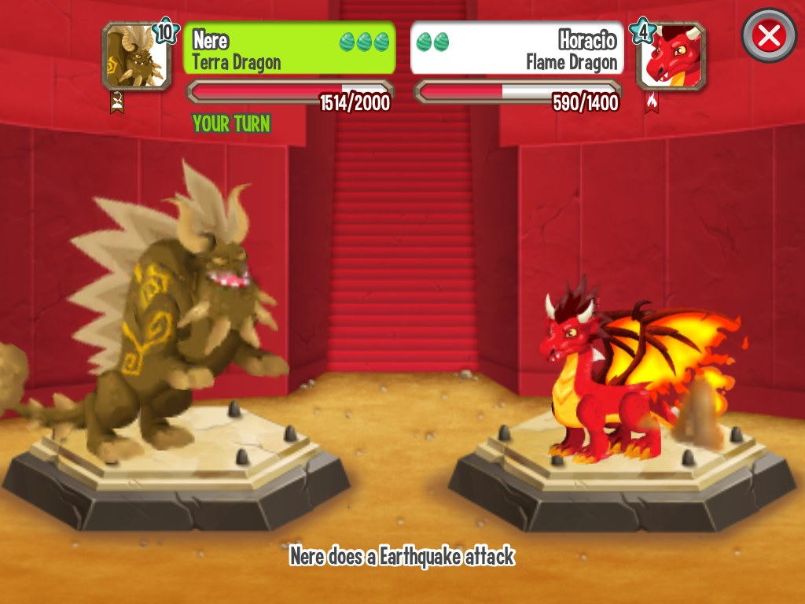
Social Point Databases
Background
Currently using Sharding because it’s easier to scale horizontally
Interested in NoSQL but finds it difficult to trust it
Growing number of users over a short period of time (between 2008 and 2012)
Problems
MySQL sometimes gets delayed because it is not fast enough
Scalability Issues
-Challenging because Social Point cannot shut down game to move data
-Must Account for 70 million users total for just Dragon City game
Uses
User Comments
User Battle Requests
Player vs. Player Mode
Social Point is currently using MySQL and although it is static, there are problems with scalability and latency.
Procedure
Critical Elements
Companies
Miscellaneous

Slide 22


Social Point Databases
Background
Tried Cassandra and Couchbase
Problems
During heavy tests: problems with stability
-Clusters break when scaling
Results
Distrust of NoSQL
Although Social Point has tried some NoSQL databases but it found stability problems, causing distrust of NoSQL.
Procedure
Critical Elements
Companies
Miscellaneous

Slide 23

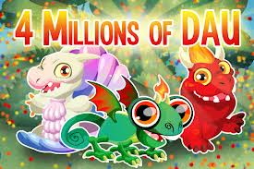
Social Point Results
Current Issues
Social Point is only using MySQL
Managing large amounts of Unstructured data in real time is important
Scalability and Latency Issues
Aerospike
High Scalability
Low latency
Create trust for NoSQL by emphasizing its stability
If Aerospike can resolve Social Point’s continuing problems, then it can still overcome the competitor CouchDB.
Procedure
Critical Elements
Companies
Miscellaneous

Slide 24
Wooga
About
Multiplayer arcade gaming company in Berlin
50 million active players every month
Jens Begemann (CEO) and Philipp Moeser (CTO)
Growth Potential
$32.2M in total funding
In top 25 for gain in monthly active users on AppData
3rd biggest game developer on Facebook platform
Games
20.2 million monthly active users for Diamond Dash
10.7 million monthly active users for Bubble Island
8.0 million monthly active users for Monster World
Wooga is a social gaming company that is growing rapidly both in users and name.
Procedure
Critical Elements
Companies
Miscellaneous

Slide 25
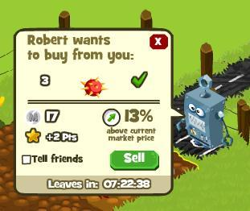
Wooga Databases
Background
Back-end Database → Easier to develop game quickly but at the expense of scalability and concurrency
Write-heavy → challenging amount of throughput to handle
Growing number of users over a short period of time (between 2009 and 2012)
MySQL Problems
MySQL becomes a bottleneck
Sharding is necessary
Slow Restores
SQL becomes more complex and can fail more easily
MySQL only scales to a certain extent
Uses
Cheat Code Prevention
Buying and Selling with Friends
Ranking with Player Scores
Tracking payments of additional power-ups
Wooga has been using MySQL for its common use but has found it to be problematic with scaling.
Agenda
Procedure
Critical Elements
Companies
Miscellaneous

Slide 26


Wooga Databases
Benefits
Benefits
Created more app servers
Faster machines and network for write-intensive data
Scales better
No sharding required for scalability
Masterless replication
Redis Problems
Riak Problems
Sensitive to Latency
Not enough data capacity to handle current traffic volume
Scalability Issues continue to not be resolved as number of games and users grow
Dreadful Ulimit limiting amount of processing users are allowed to have running at the same time
Riak scales better but Wooga needs more scability to cope with larger user base
By using Redis and Riak, Wooga continues to suffer with scalability despite current solutions .
Agenda
Procedure
Critical Elements
Companies
Miscellaneous
Notes:
Problems:
Sensitive to Latency
Memory Leaks
Database dumps begin to stop working
Redis Disk Store never really supported Wooga Restores
Frequent Downtime
Not enough data capacity to handle current traffic volume
Scalability Issues continues to not be resolved as number of games and users grow
Redis only makes data interaction faster than when using solely MySQL

Slide 27
Wooga Results
Current Issues
Wooga uses a combination of MySQL, Redis, Riak, and CouchDB
MySQL, Redis, and Riak are being used for games, which have structured data
For tracking and error reporting (unstructured data), Wooga uses CouchDB
CouchDB
High throughput (Monster World has 200,000 DB operations per second at peak)
CouchDB does not resolve all of the scalability and latency issues
Aerospike
Scalability
Higher throughput than CouchDB
Low latency
Apply database to use case of dashboards and fast feedback after new releases
If Aerospike can resolve Wooga’s continuing problems, then it can still overcome the competitor CouchDB.
Procedure
Critical Elements
Companies
Miscellaneous

Slide 28

Three Rings Design Inc.
Three Rings
SEGA Corporation
Casual MMO games developer.
Platforms: Online, ‘Whirled’, Facebook
Acquired by SEGA in 2011.
Puzzle Pirates: $4 million in 2007. $1 million: subscriptions, more than $3 million: virtual currency.
Parent Company: Sega Sammy Holdings Inc.: Revenue = $4.335 billion (2012)
SEGA Corp: Revenue = $513 million (2011)
2,600 employees
Consistently ranks among the top 12 video game publishers worldwide.
Japan: number one gaming software maker.
Aggressive acquisitions.
Social and smartphone gaming: main market for growth
New Sega Network: Social and Online Gaming
Three Rings Design is an MMO game developer whose parent corporation is expanding and promising.
Procedure
Critical Elements
Companies
Miscellaneous

Slide 29
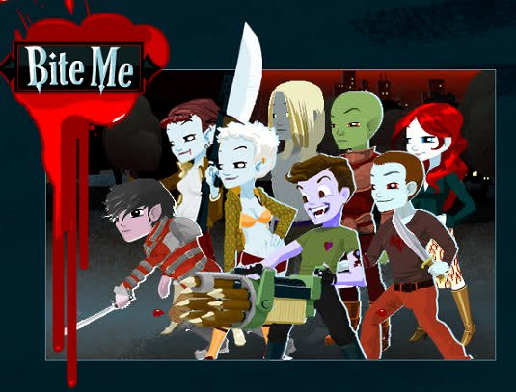
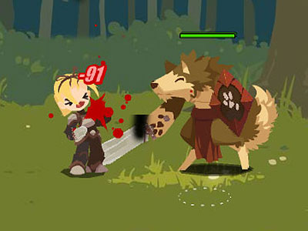
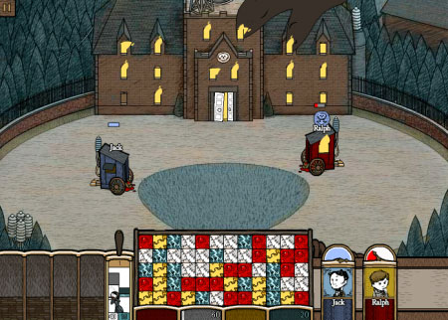
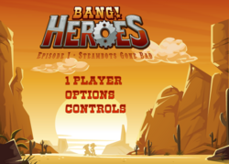
Three Rings Games
ONLINE
FACEBOOK
WHIRLED
Game Developers Choice Online Award Winner (2011)
Game of Everything
Brawler
Corpse Craft
Three Rings has games that are played either on their website, on Facebook, or on their website Whirled.
Procedure
Critical Elements
Companies
Miscellaneous

Slide 30
Three Rings Database
General Information
Policy: small need for relational databases
Future: host different tables on different database servers
Prefer SQL over NoSQL: transparent and structured command line access to data
Open to technology shift if needed
PostgreSQL
MySQL
Changed to
Adherence to standards
Consistency of design
Performance
Steady improvement through years
Many versions
Rampant JDBC bugs
Backward compatibility hacks
How does Aerospike Fit into this?
Being NoSQL, it does not require JDBC.
If it can provide backward compatibility, could be a Postgres alternative
Performance!
Three Rings uses SQL for need of simplicity but wants to scale in future.
Procedure
Critical Elements
Companies
Miscellaneous

Slide 31
Three Rings Database
Scalability
Latency
Want to scale easily in future: host different tables on different database servers
No need for scalability yet in relation to user base size. Possible in future.
Had to curtail design in the past so that it is not database-intensive
Did not have to make crucial changes that database could not handle: could occur in future.
Interested in low latency
Easy for database to get saturated DB disks, but bypassing the issue with Amazon EC2: SSD based sequential I/O performance
Main consideration: responsiveness to user
Interested in SSDs.
Looked at Cassandra, DynamoDB: both appealing
Investing in new technology not justified
Real-Time & Others
Throughput
When a player logs on, too much seeking. Replace with a single key/value read.
Risk of losing players’ information in the case of a power outage & money transactions: Aerospike: no power outage, no data loss. PostgreSQL: security vulnerability.
No need for JOINs.
Experience I/O bottlenecks
Available I/O bandwidth not yet saturated, but possible in the future
Lot of writing, so throughput crucial
Aerospike: 10X performance advantage
Three Rings provides a number of use cases for Aerospike.
Procedure
Critical Elements
Companies
Miscellaneous

Slide 32
Three Rings Conclusion
Requirement | Aerospike
No or few relational abilities | NoSQL: non-relational
Structured access to data | NoSQL: Unstructured access
Backward compatibility | Can Aerospike successfully avoid blocks?
Performance | Best in the business
Want to scale in future: design changes, more users | Immensely scalable
Low latency: quick responsiveness to user, especially during logging in | Fast response times even when nodes are down
Need key/value to optimize | Key/value database
Concern: power outage, losing data | No outage or data loss
I/O Bottlenecks | Flash technology: 10X advantage
Aerospike can be a solution to a number of problems for Three Rings.
Procedure
Critical Elements
Companies
Miscellaneous

Slide 33

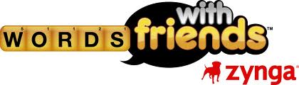


Zynga
Fact Sheet
Why is throughput important?
60 million daily active users
240 million monthly active users
Platforms across Android, Facebook, and iOS
In top 50 largest gaming companies by revenue
Leading social gaming company
Zynga has many uses for real-time data. Most of their use cases rely on streaming when customers want fast analytics on large amounts of data. Zynga’s most popular games are social, and require many read writes per second for player interaction and analytics.
Popular Games
Create words out of lettered tiles to rack up points
Plant crops, visit friends, and share the fun
Roll the dice and try your hand at Zynga’s classic first game
Procedure
Critical Elements
Companies
Miscellaneous

Slide 34


Zynga Databases
Used for: Warehouse
MPP architecture, column storing
Fully SQL compliant
Vertica stores more than 1 Petabyte of compressed data
Used for: Finance
Strong security
Financial Datamart
Used for : Streaming
High read write performance
Used for mainy social gaming analytics
Procedure
Critical Elements
Companies
Miscellaneous

Slide 35

Zynga
Why is latency important?
Example
Latency is especially important for streaming social games. Low latency can open up avenues for various use cases. In the traditional warehouse were they build, which then aggregates and surfaces via UI, is too slow, and has high lead time. However, presently Zynga has solved this with their MySQL database.
Zynga Poker Plus
Actual money
Update grouping methods
Require many real time analytics with low lead time
Source: Google Finance
Procedure
Critical Elements
Companies
Miscellaneous

Slide 36






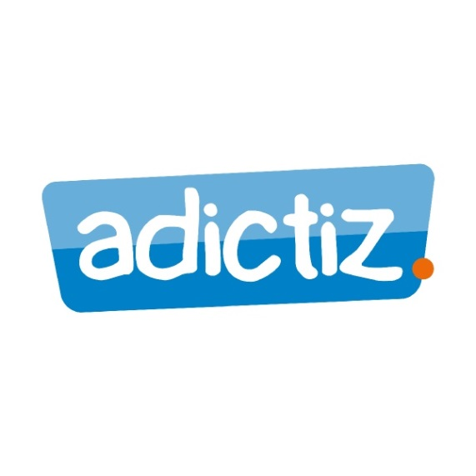


Potential Contacts
Procedure
Critical Elements
Companies
Miscellaneous

Slide 37

Professor Ray Larson
Interview
Professor Larson was interviewed about use cases for fast real time data interaction in the gaming industry, but provided information about the finance industry as well.
While talking about technical problems, and how to solve them, he saw technology as not needed in the gaming industry, but more crucial to finance. Gaming companies in his mind did not presently have any use of Aerospike’s speed in throughput speeds, but finance might. The finance industry is comparatively more speed based, and faster databases are important to churn more profit for every high frequency transaction.
Dr. Ray Larson is a professor at UC Berkeley’s School of Information. He specializes in information retrieval and database systems with an emphasis on system internals. He has worked on architecture for SQL, MySQL, BerkeleyDB and may other database systems.
Procedure
Critical Elements
Companies
Miscellaneous

Slide 38




Finance Industry
Industry Comparison
Why consider Finance?
Larger than the gaming industry
More regulations
Higher frequency of interaction
More saturated
Wall Street has many high frequency transactions, often millions a day. What if a boutique or investment bank were to make every transaction and save themselves 1/10,000 of a cent? This would translate to much larger profits. Finance is an industry in which every millisecond counts. Low latency and analytics is much more important in finance.
Why not?
As a potentially lucrative industry, the finance industry has many more regulations as compared to gaming. This may be more costly for Aerospike, and result in a total overhaul of its database systems. The finance industry is also oversaturated, as it is rare for a new boutique to become a major investment bank. Whereas compared to finance, gaming is highly cyclical and new companies can easily experience a higher compound annual growth rate.
Procedure
Critical Elements
Companies
Miscellaneous

Slide 39
Conclusion
Summary
The gaming industry is a worthwhile venture for Aerospike to pursue. We have proven with our sample of the gaming industry that companies are interested in Aerospike’s strengths.
Trends
Many companies which have used MySQL from the very beginning, and are not currently satisfied. They are unhappy with the scalability aspects when the companies grow.
Social games need high input-output bandwidths. Higher read writes allow for more fluid gaming.
Analytics require lower lead times.
Scalability
Throughput
Latency
Procedure
Critical Elements
Companies
Miscellaneous

Slide 40
Thank you for your time

Slide 41
Appendix

Slide 42
Appendix - Companies
Lvl6
http://www.lvl6.com
Kelly, Senior Engineer at lvl6
Wooga
http://www.crunchbase.com/company/wooga
http://www.appdata.com/devs/31504-wooga
http://www.slideshare.net/wooga
Jesper Richter-Reichhelm, Head of Engineering at Wooga
Social Point
http://www.crunchbase.com/company/social-point
http://www.appdata.com/devs/66241-social-point
Marc Canaleta, CTO at Social Point
Phoenix Guild
http://www.crunchbase.com/company/phoenix-guild
Jason Citron, CEO at Phoenix Guild
Zynga
https://zynga.com/
Sudhish Iyer, Database Architect at Zynga

Slide 43
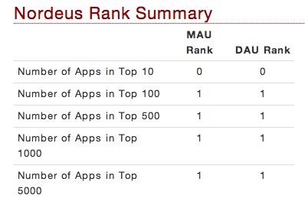
Appendix - Nordeus
Founded in 2010 by ex Microsoft engineer Branco Mulitinovic; CTO
One product—Top Eleven Football Manager
Self-funded; no outside VC funding
“Top Eleven Football Manager” – top 10 gaming apps on Facebook in DEC 2012
http://www.appdata.com/devs/35303-nordeus
http://www.appdata.com/apps/facebook/109306535771-top-eleven-be-a-football-manager

Slide 44
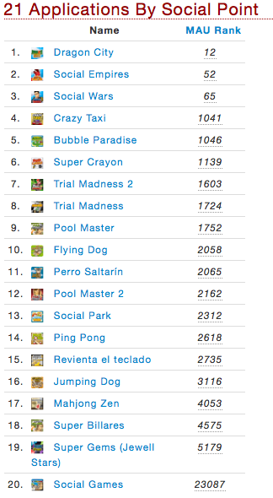
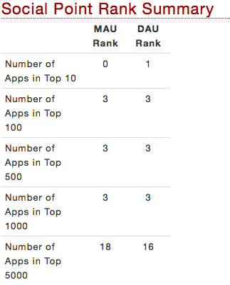
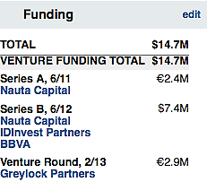
Appendix - Social Point
“Social Point is one of the top 5 global developers of social games. Their games are played by over 30 million monthly active users on Facebook and mobile platforms.
The company was founded by Andrés Bou, Horacio Martos and Marc Canaleta in 2008 and has since released three hit games (Social Empires, Social Wars and Dragon City), with a strong pipeline of innovative games to be released in the near future.”

Slide 45
Appendix – Three Rings
SEGA Corp.: Japanese multinational company.
Experts contacted at Three Rings:
Ray Greenwell: Senior Software Engineer
Par Winzell: Senior Software Engineer
SEGA*:
*http://news.yahoo.com/top-iphone-ipad-apps-app-172926481.html

Slide 46
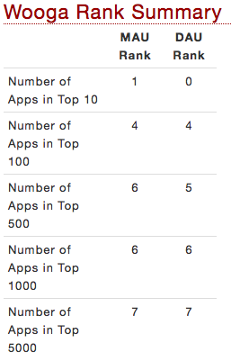
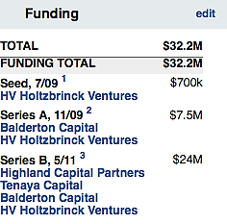
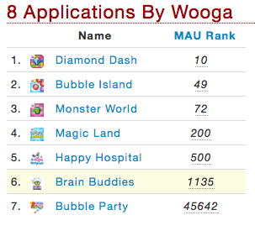
Appendix - Wooga
“Founded in 2009 by Jens Begemann and Phillip Moeser, Wooga is the third largest social games developer in the world with over 200 employees from 35 different countries. Based in Berlin, Wooga creates high quality social games for Facebook and iOS, with a specific focus on emotional character development, usability, and superb localization in seven languages.
Since 2009, Wooga has focused on organic growth to steadily grow it’s team and expand from Facebook to mobile platforms.”
Other Games: Brain Buddies, Happy Hospital, Magic Land

Slide 47
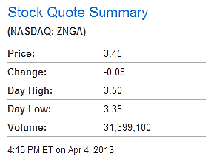
Appendix - Zynga
“Zynga was founded in July of 2007 by Mark Pincus. The early supporting founding team included Eric Schiermeyer, Michael Luxton, Justin Waldron, Kyle Stewart, Scott Dale, Steve Schoettler, and Andrew Trader.”
“Zynga Inc. (NASDAQ: ZNGA) is the world's leading provider of social game services with more than 240 million monthly active users playing its games, which include CityVille, Zynga Poker, Draw Something, Hidden Chronicles, FarmVille, CastleVille, Words With Friends, Empires & Allies, Scramble With Friends, Café World, The Pioneer Trail, Indiana Jones™ Adventure World and Mafia Wars. Zynga's games are available on a number of global platforms, including Facebook, Zynga.com, Google+, Tencent, Apple iOS and Google Android. Through Zynga.org, Zynga players have raised more than $10 million for world social causes.”
Source: Zynga
Major Zynga Games
CityVille
Empires & Allies
Farmville
The Pioneer Trail
Mafia Wars
Zynga Poker
Words with Friends
Source: Google Finance
Zynga Poker Plus
When Zynga starts to deal with gamblers using actual money, they will have to no doubt to update their grouping methods for tables. Tables have to be balanced. A table which has all conservative betters will be considered a bad table, since it is not balanced well. Zynga will require many real time analytics to compute their grouping methods, which will rely heavily on low latency and low lead times.

